Slide 1


@A2Z Contact!
An app for easy contact storage.
BY: Serah Karanja

Slide 2
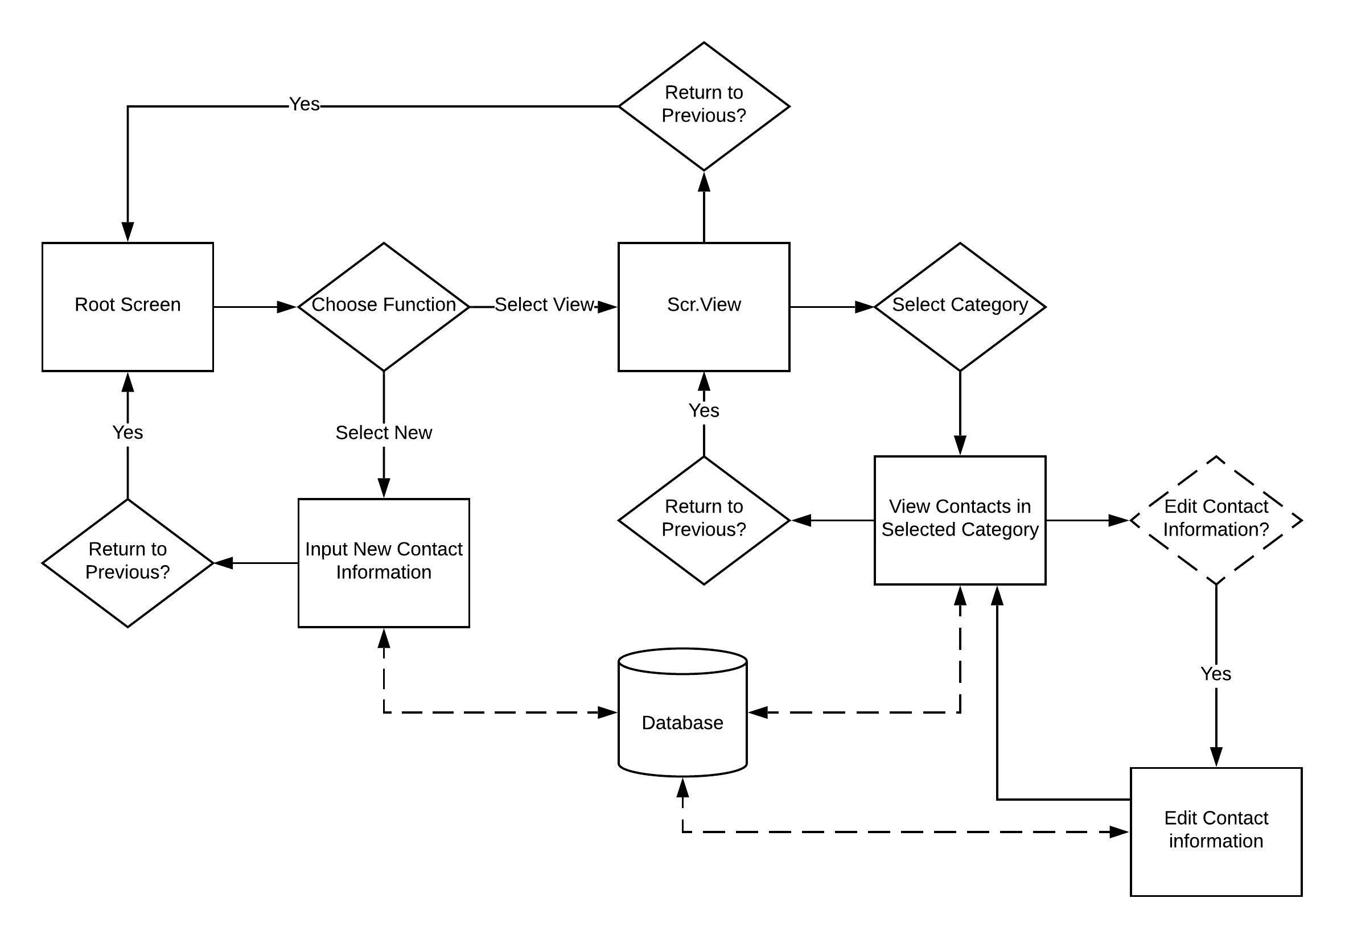

Slide 3


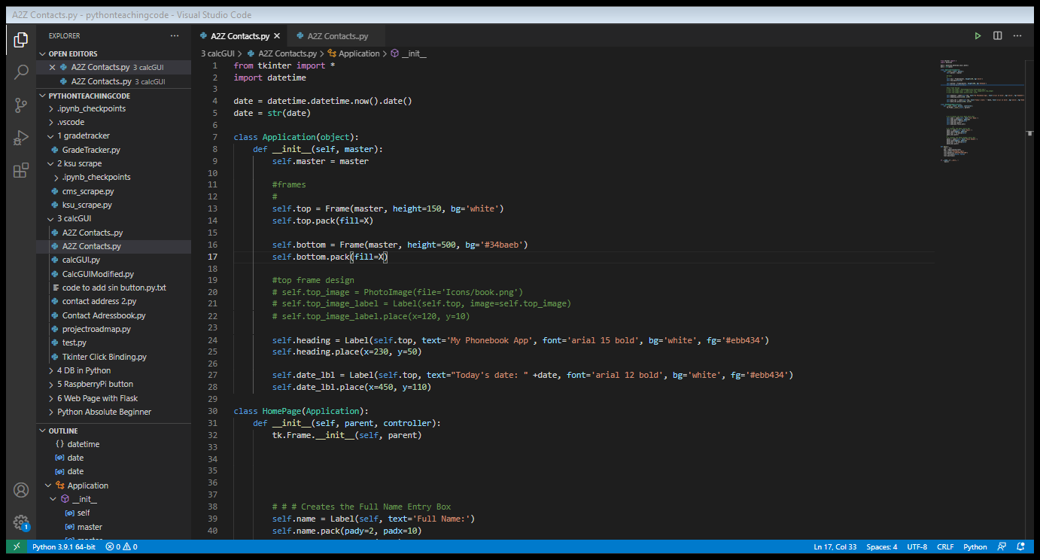

Slide 4
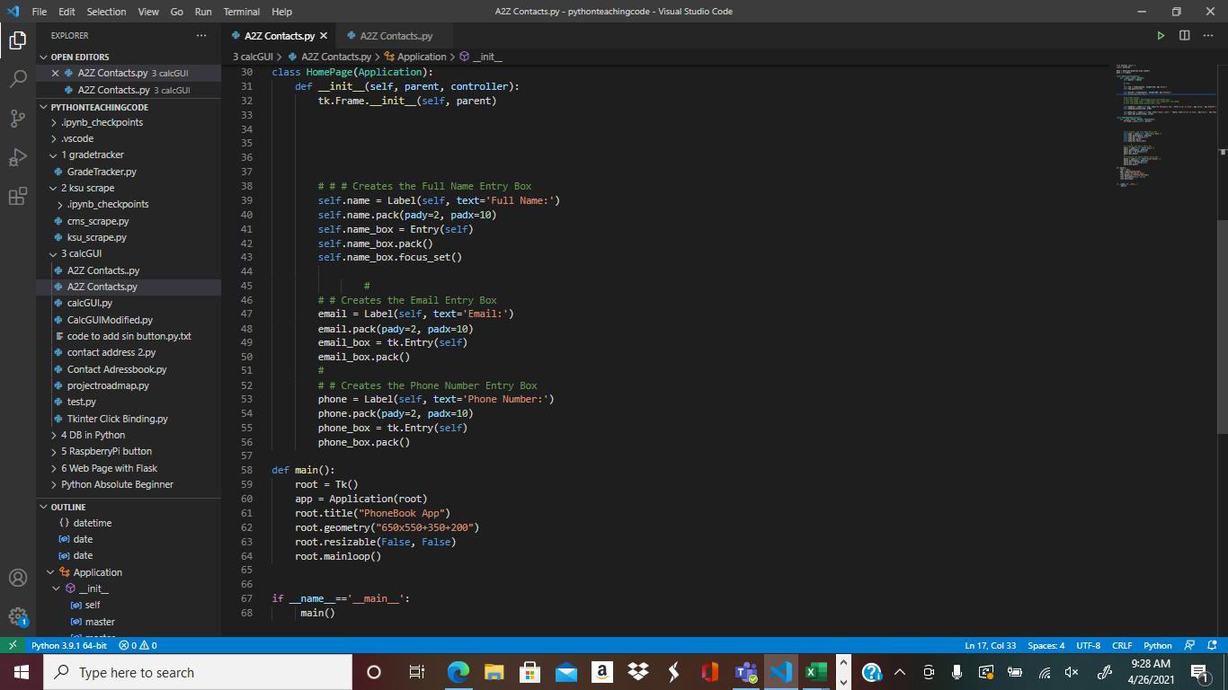

Slide 5
